Slide 1
Recitation 11

Slide 2
Info
Jon Rutkauskas
Recitation: Tue 12-12:50
Office Hours: Tue 11-11:50 Thur 11-12:50 SENSQ 5806 (additional hours by appointment if needed)
On discord: @jrutkauskas
By email: jsr68@pitt.edu
Website: https://github.com/jrutkauskas/spring2019-449-rec
Ask me any questions you have!!!

Slide 3
Warmup PollS

Slide 4
“Stick” Around…
“Stick” around until after this presentation is over for a fun surprise I brought for all of you…
I think you’ll find it very aPEELing
…
…
…
The surprise is stickers. I bought you all some fun stickers and you each can have one every time you come to recitation.

Slide 5
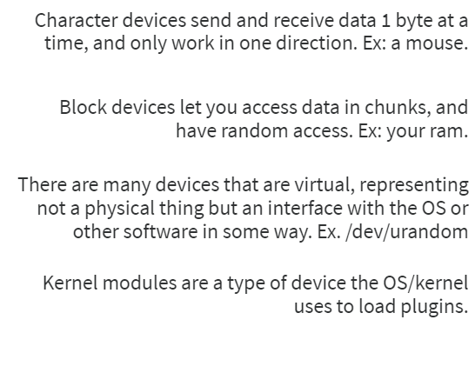
Which of the following is –NOT- true regarding the different types of devices

Slide 6
Which of the following is –NOT- true regarding the different types of devices
Kernel Modules are like plugins for the OS.
We write device drivers as kernel modules so the OS can load them dynamically
All the other statements are true definitions.

Slide 7
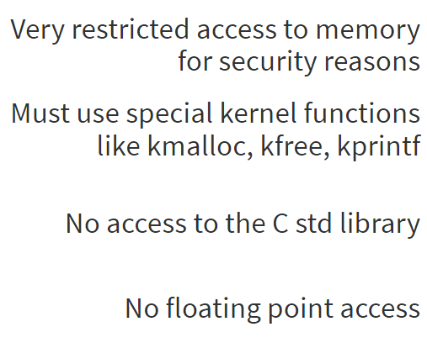
Which of the following is –Not- a limitation of writing code that runs in the Kernel

Slide 8
Which of the following is –Not- a limitation of writing code that runs in the Kernel
The kernel actually has basically UNRESTRICTED access to memory. You can access kernel memory and user memory, though you do need the copy_to_user(…) function.
The kernel has no C std library, so malloc, free, printf are out of the question, but we have kernel ~equivalents. They differ in some ways, though, so it’s a good idea to read the man pages (as always).
^^
To save time on context switches, the kernel doesn’t allow access to the floating point registers, so it doesn’t have to save them… meaning it can’t use them, so no floating point access!

Slide 9
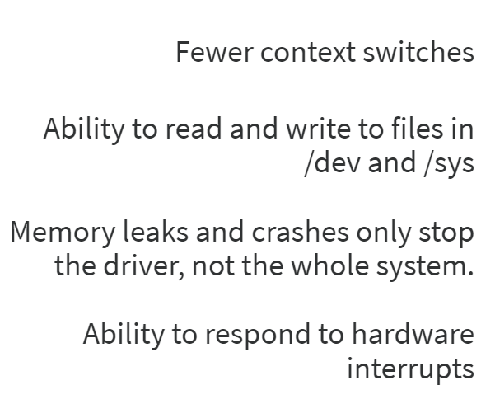
Which of these is an advantage a user-mode driver has over a kernel-mode one?

Slide 10
Which of these is an advantage a user-mode driver has over a kernel-mode one?
User-mode drivers actually have MORE context switches, since all operations need to go through the kernel. Program → kernel → driver → kernel → Program.
Vs. Program → kernel (and driver) → Program
Daemons, how we run user-mode drivers, have higher privileges and can use /dev and /sys… kernel mode drivers, of course, can do this too, so this is not an advantage.
When any user-mode program leaks memory, all you have to do to free the memory is kill the program, in kernel, you’d have to restart the system. When a user-mode program crashes… you’ve seen it. It just stops working and maybe prints a message to the screen (Segmentation Fault. Core dumped)
Only kernel-mode drivers can respond to hardware interrupts.

Slide 11
Other questions on this material
This is all getting a lot more conceptual and a lot harder to make examples of
Are there questions about the concepts you’ve learned in the last few lectures?

Slide 12
No Lab this week!
Project 4 is due this weekend, though.
Remember not to forkbomb thoth. See the instructions on the project description, or from your class slides, or from my Recitation 10 slides… or just ulimit –u 30 every time you login
I want you to have some time to work on that and be able ask me questions.
Is anyone having trouble with strtok?
Anything else, I am here!
Also you can get a sticker now. :-)

